Slide 1
Forecast families results

Slide 2
Definition of the operation objective
Operation objective = max (water availability increase + a * pumping savings)
Notes:
The a weight factor is used to give the same weight to both objectvices in the balance approach

Slide 3
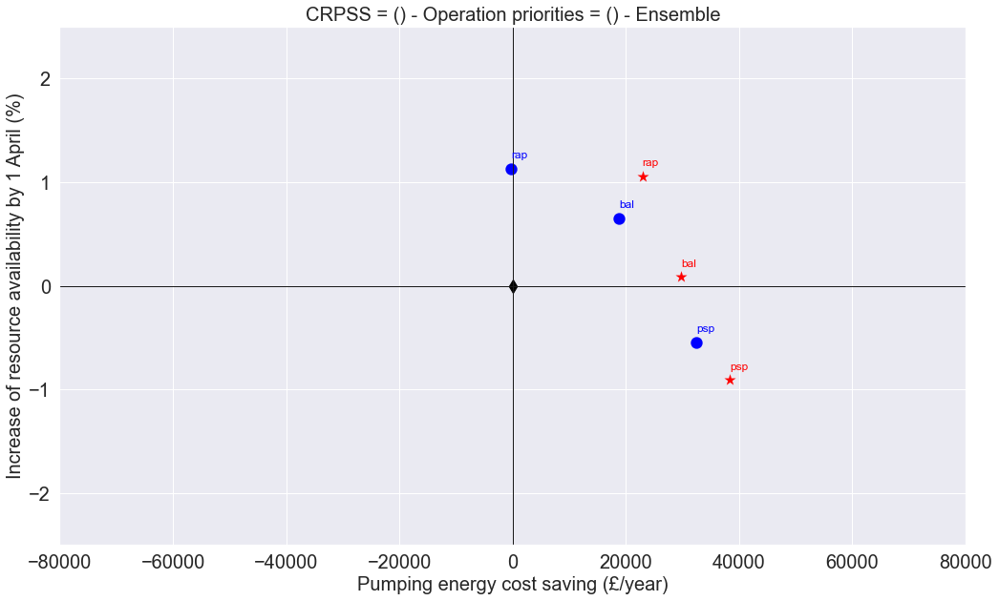
a
y = x * 1.2 / 27000 *10
y = x * 1.2 / 27000 *2
y = x * 1.2 / 27000
y = x * 1.2 / 27000 /2
y = x * 0.12 / 27000 /10
Notes:
This is how a is defined. The blue points are taken from our previous study (Peñuela et al, 2020)
5 different weights (*/10 and */5)
Draw a matrix (colormap) skills vs weights
Start with results of the aggregated performance (pump + resource *a) and then look at each objective more in detail

Slide 4
Definition of the operation objective
Resource avail only (rao) = max (water availability increase + 1.2/27000 /10 * pumping savings)
Resource avail prioritised (rap) = max (water availability increase + 1.2/27000 /2 * pumping savings)
Balanced (bal) = max (water availability increase + 1.2/27000 * pumping savings)
Pumping savings prioritised (psp) = max (water availability increase + 1.2/27000 *2 * pumping savings)
Pumping savings only (pso) = max (water availability increase + 1.2/27000 *10* pumping savings)
Notes:
The a weight factor is used to give the same weight to both objectvices in the balance approach

Slide 5
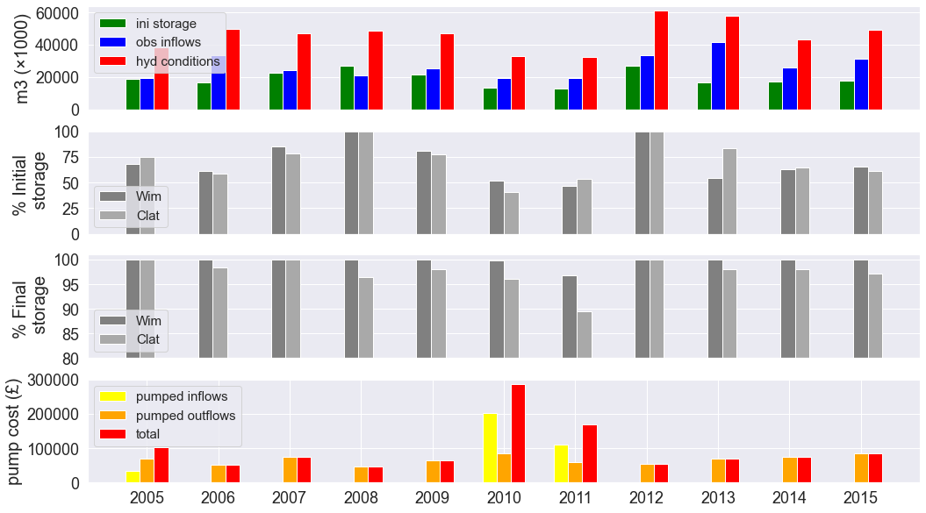
*hydrological conditions = initial storage + total infllows
Observed data
More room for improvement in 2010 and especially, in 2011
Benchmark performance
More room for improvement in 2011 and especially, in 2010
Notes:
2005, 2010 and 2011 are the driest years
In terms of resource availability, in 2011 is when there is more room for improvement in terms of benchmark performance, followed by 2010.
In terms of pumping savings, 2005, 2010 and 2011 are the years when there is more room for improvement in terms of benchmark performance

Slide 6
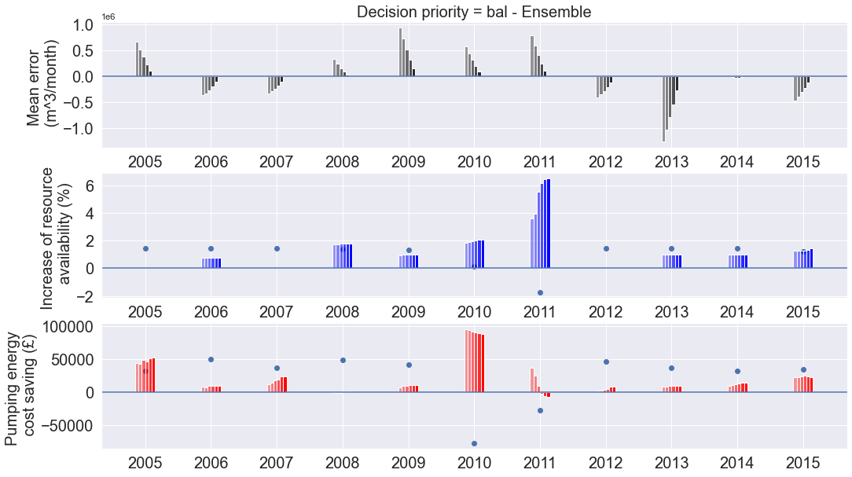
Balanced objectives (BAL)
ESP
dry years (historically: high pumping, low resource )
Largest gains in terms of resource availability in 2011, the year when the benchmark performs the worst in terms of resource avialability
Largest gains in 2010, which is the year when benchmark performs the worst in terms of pumping cost
Largest variations of value with skills in 2011
In terms of value, 2011 is the most sensitive to forecast skill
Notes:
For most of the years there is a real improvement of the forecast value with skills, with the exception of 2010 and 2011 (driest years). In 2010 and 2011 one objective improves at the cost of the other one.

Slide 7
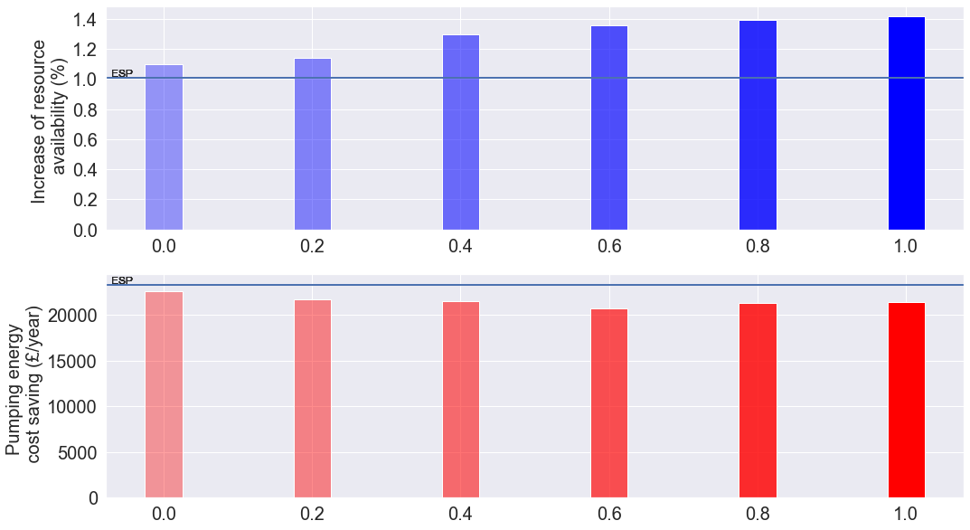
maximised
VALUE →
Resource Availability Prioritised (RAP)
constrained
Increase in value with skill more clear for Res. Avail. (although there is a small decrease in value for Pump.
The average weighted value of both objectives increases with skills: 1.02, 1.08, 1.12, 1.14, 1.17, 1.18
Balanced objectives (BAL)
VALUE →
maximised
maximised
constrained
VALUE →
Pumping Savings Prioritised (PSP)
maximised
SKILL (CRPSS) →

Slide 8
Correlation between forecast value and skills and initial storage in 2010 and 2011

Slide 9
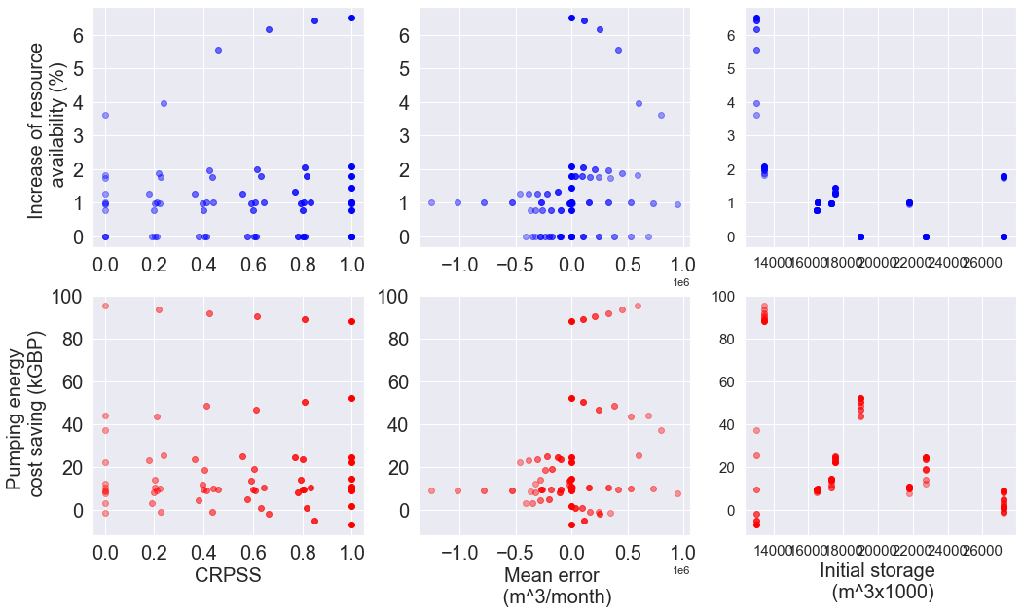
Balanced objectives (BAL)
2010
2005
2007
2012
2011
2009
2008
With the exception of 2011, there seems to be a Good correlation (inverse) between initial storage and pumping savings

Slide 10
Forecast skills results

Slide 11
Mean error (in what years the inflows are overstimated or understimated? And how the mean error changes with the changes in CRPSS?)

Slide 12
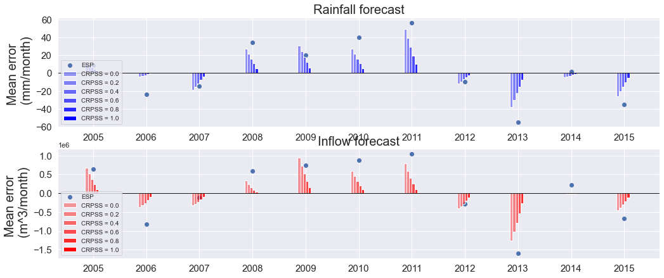
Notes:
The mean error is reduced proportionally with the increase of CRPSS
In terms of inflows, 2005, 2009 and 2011 are the years with the highest overstimation. 2013 has the highest inflow understimation

Slide 13
How the improvement of the rainfall forecast skills affects the inflow forecast skills

Slide 14
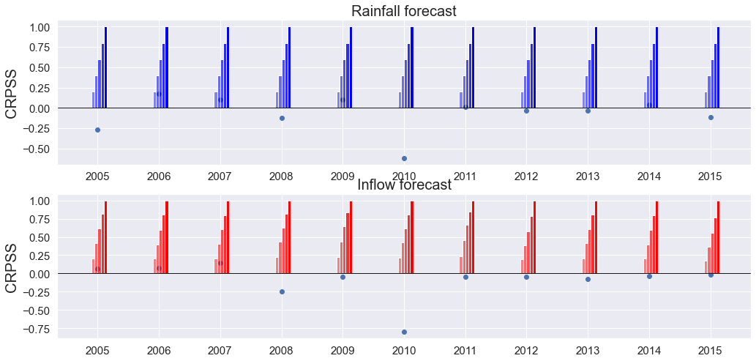
ESP

